Slide 1
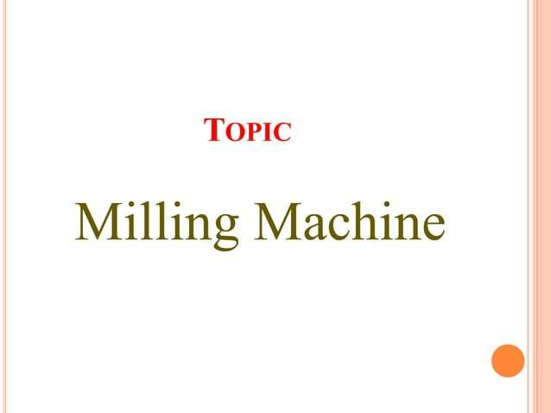

Slide 2
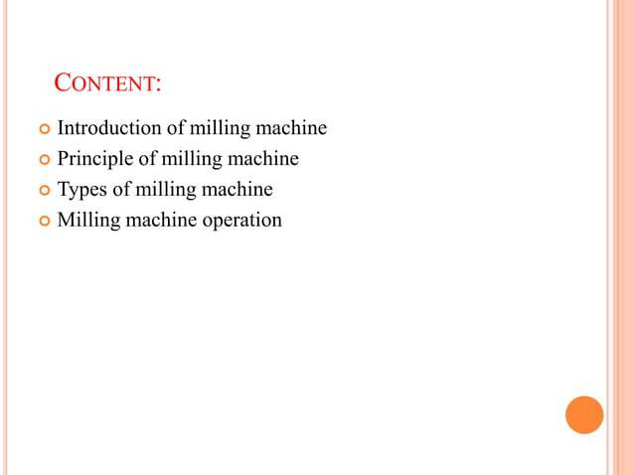

Slide 3
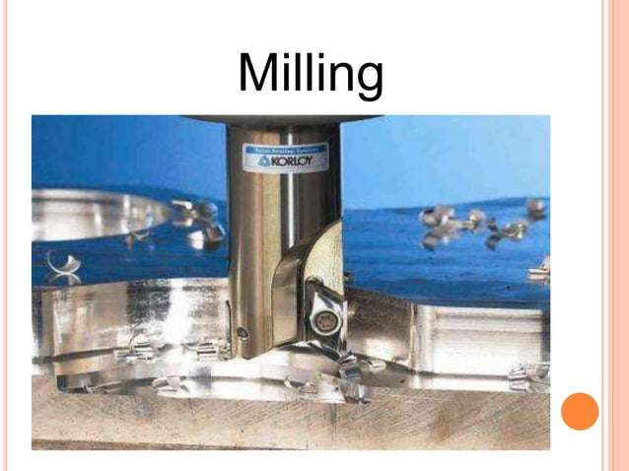

Slide 4
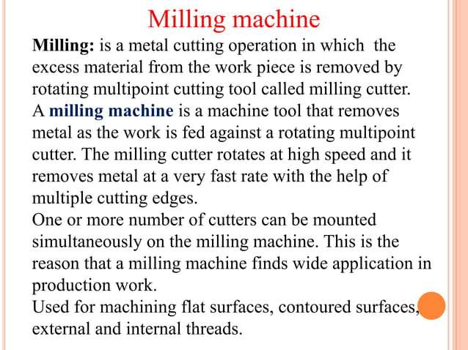

Slide 5
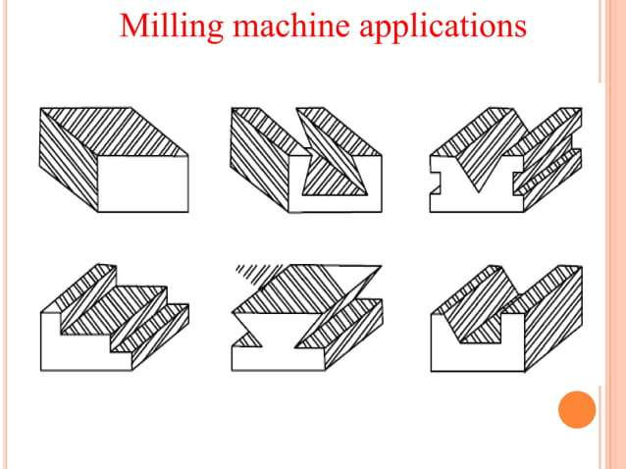

Slide 6
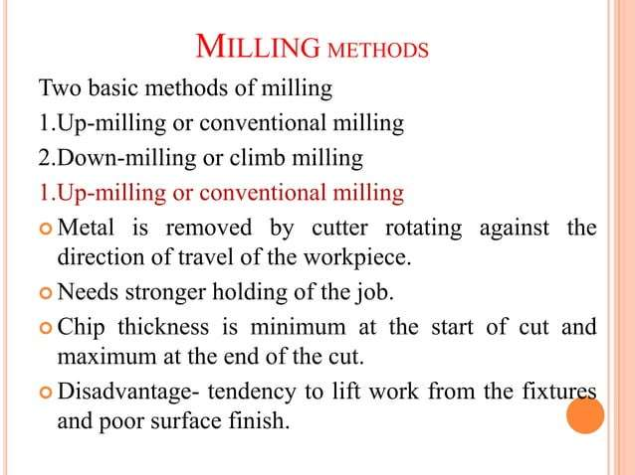

Slide 7
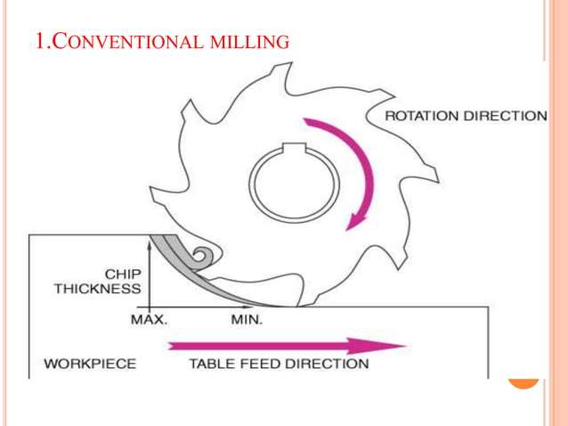

Slide 8
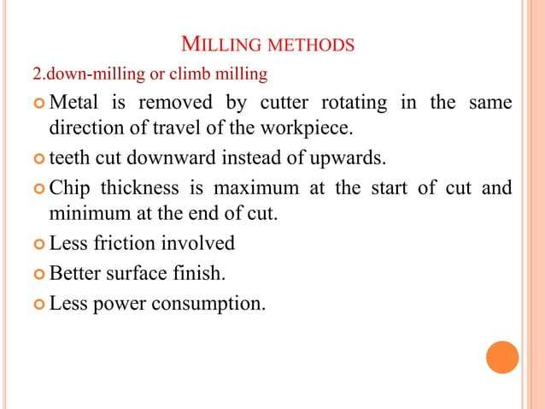

Slide 9
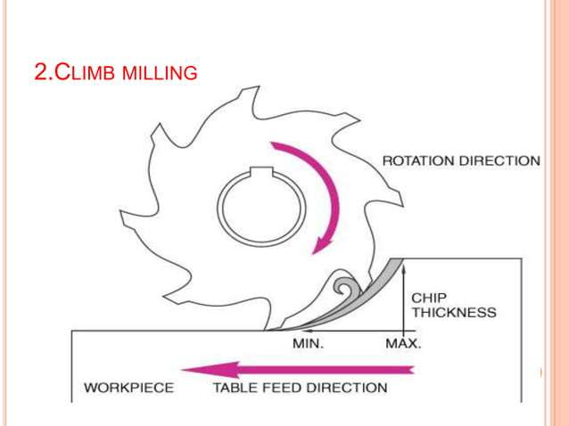

Slide 10
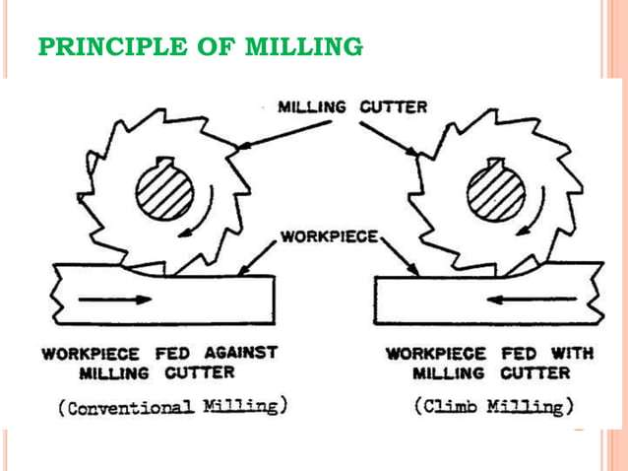

Slide 11
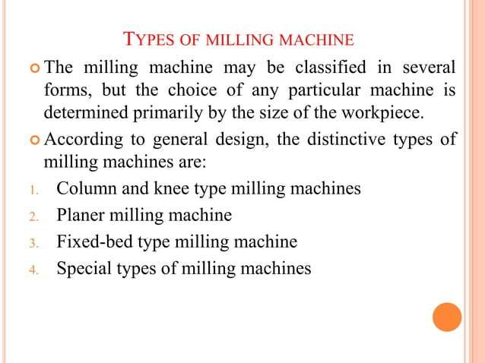

Slide 12
Types of Milling Machines
The Milling machine may be classified in several forms, but the choice of any particular machine is determined primarily by the size of the workpiece.
According to the general design, the distinctive types of milling machines are:
1. Column and Knee type milling machine
2. Fixed bed type or Manufacturing type milling machine
3. Planer type milling machine
4. Production milling machine
5. Special Purpose machines

Slide 13
1. Column and Knee type Milling Machine:
These machines are general purpose and have single spindle only.
They derived their name Column and Knee type from the fact that the work table is supported on knee like casting.
These machines depending upon the spindle position and table movements are further classified as follows:
a) Hand milling machine
b) Plain or Horizontal Milling machine
c) Vertical Milling machine
d) Universal Milling Machine
e) Omniversal Milling machine

Slide 14
FIXED BED TYPE OR MANUFACTURING TYPE MILLING MACHINES
These machines, in comparison to the column and knee type, are more sturdy and rigid, heavier in weight and larger in size.
They are not suitable for tool room work.
Most of these machines are either automatic or semi-automatic in operation.
They may carry a single or multiple spindles.
The common operations performed on these machines are slot cutting, grooving, gang milling and facing.

Slide 15
Their further classification is as follows:
Plain type (having single horizontal spindle).
(b) Duplex head (having double horizontal spindles).
(c) Triplex head (having two horizontal and one vertical spindle).
(d) Rise and fall type (for profile milling).
3) PLANER TYPE MILLING MACHINES
They are used for heavy work. Upto a maximum of four toolheads can be mounted over it, which can be adjusted vertically and transverse directions.
It has a robust and massive construction like a planer.

Slide 16
4)PRODUCTION MILLING MACHINES
They are also manufacturing machines but differ from the above described machines in that they do not have a fixed bed
They include the following machines:
(a) Rotary table or continuous type.
(b) Drum type
(c) Tracer controlled.

Slide 17
5. SPECIAL PURPOSE MILLING MACHINES
These machines are designed to perform a specific type of operation only.
They include the following machines:
(a) Thread milling machine
(b) Profile milling machine
(c) Gear milling or gear hobbing machine
(d) Cam milling machine
(e) Planetary type milling machine
(f) Double end milling machine
(g) Skin milling machine
(h) Spar milling machine.

Slide 18
Column and Knee type Milling Machine:
a) Hand milling machine:
It is the simplest of all the milling machines and smallest in size.
All the operations, except the rotation of arbor, are performed by hand.
The table, carrying the work over it, is moved by hand to feed the work.
This machine is specially useful in producing small components like hexagonal or square heads on bolts, cutting slots on screw heads, cutting key ways, etc.

Slide 19
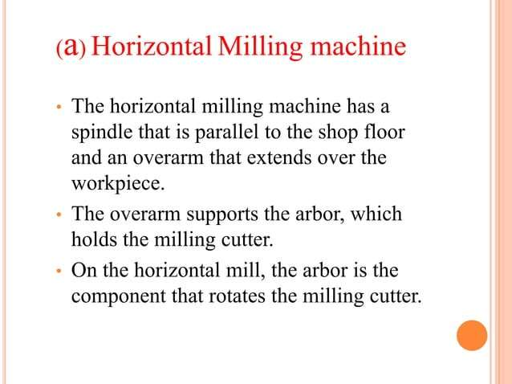

Slide 20
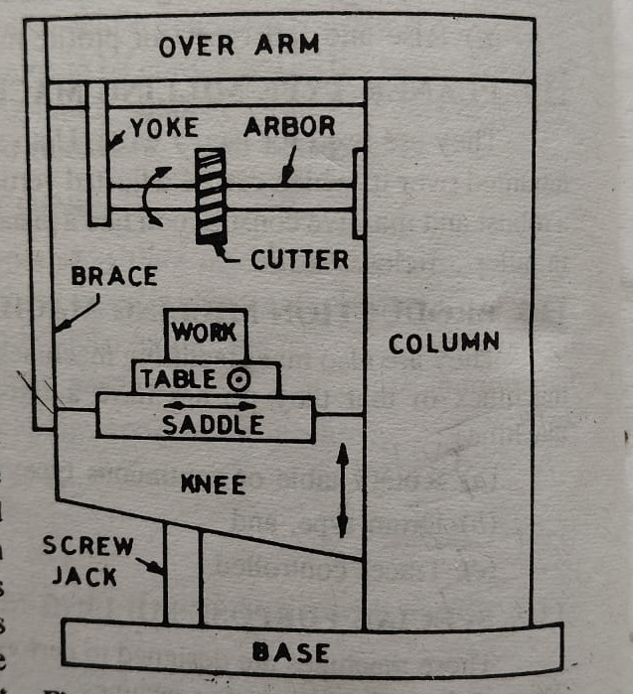

Slide 21
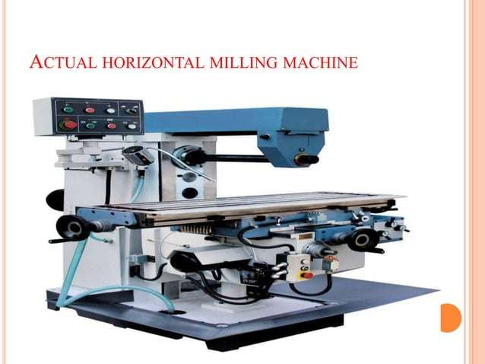

Slide 22
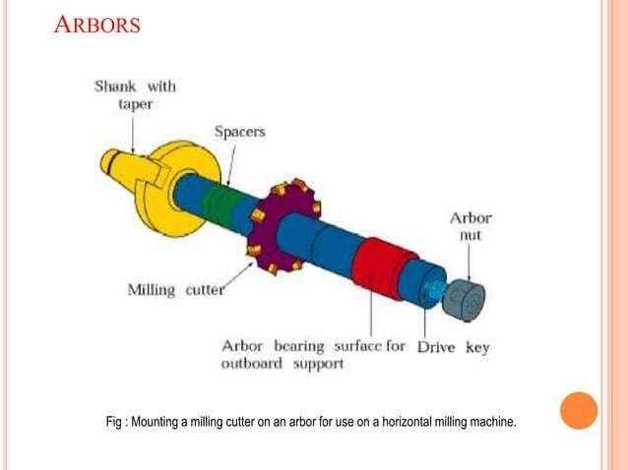

Slide 23
Applications:
Slotting and Keyway Cutting
Cutting slots, grooves, and keyways on shafts or gears.
Gear Cutting
Manufacturing different types of gears such as spur gears, helical gears, and worm gears.
Machining of Flat Surfaces
Producing flat surfaces on work pieces with high accuracy.
Contour Milling
Milling complex shapes and contours, especially on large and heavy components.

Slide 24
c) Vertical milling machine:
It derives its name from the vertical position of the spindle.
This machine is available in both types;
a) fixed head type
b) swivelling head type
Applications:
Face Milling
Creating flat surfaces or faces on a workpiece.
Slotting and Grooving
Cutting slots, keyways, or grooves in components.
Drilling, Boring, and Reaming
Vertical mills often serve as drill presses to perform accurate drilling operations.
Complex Contour Milling
Producing intricate shapes, contours, and profiles on a workpiece.
Engraving
Detailed engraving or lettering on metal or other materials.

Slide 25
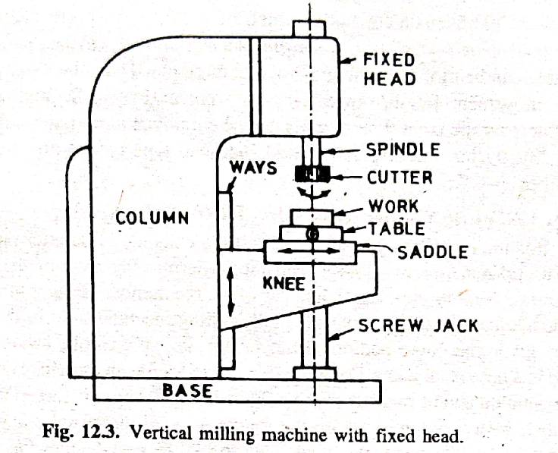

Slide 26
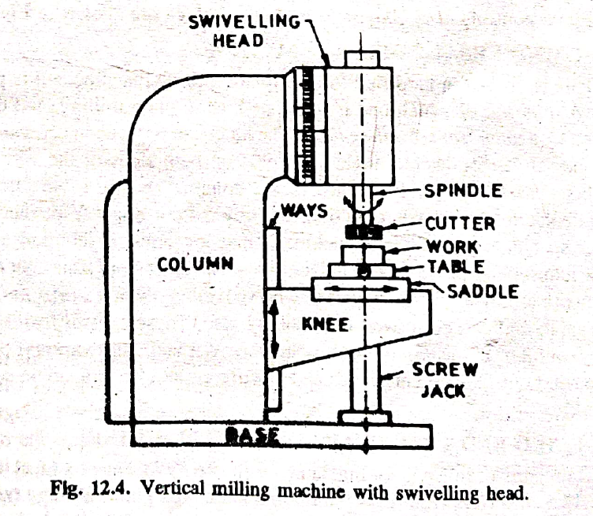

Slide 27
Orientation of the Spindle and Cutter
Horizontal milling machine: The spindle is horizontal, so the cutter is mounted on an arbor that extends sideways. This makes it excellent for:
Heavy, deep cuts on larger, heavier workpieces.
Cutting wide slots and keyways efficiently.
Using multiple cutters on an arbor simultaneously (e.g., straddle milling).
Vertical milling machine: The spindle is vertical, so the cutter points downwards. This makes it better for:
Precision and detailed work on smaller parts.
Easy setup and operation for drilling, boring, and slotting.
Versatility with different tools (end mills, face mills, drill bits).

Slide 28
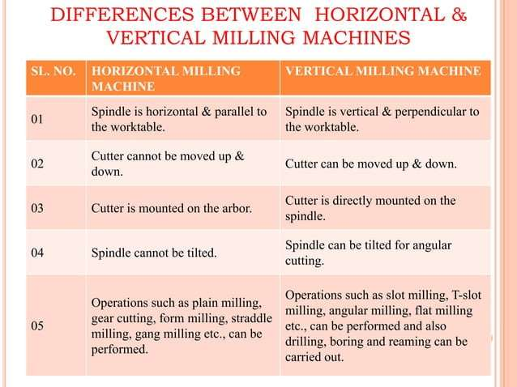

Slide 29
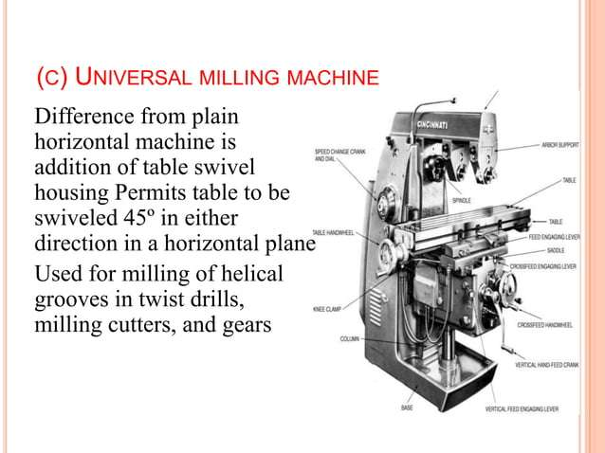

Slide 30
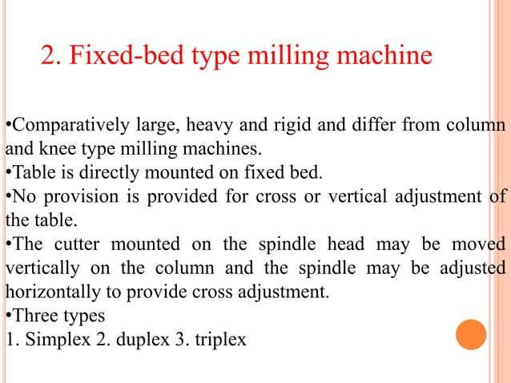

Slide 31
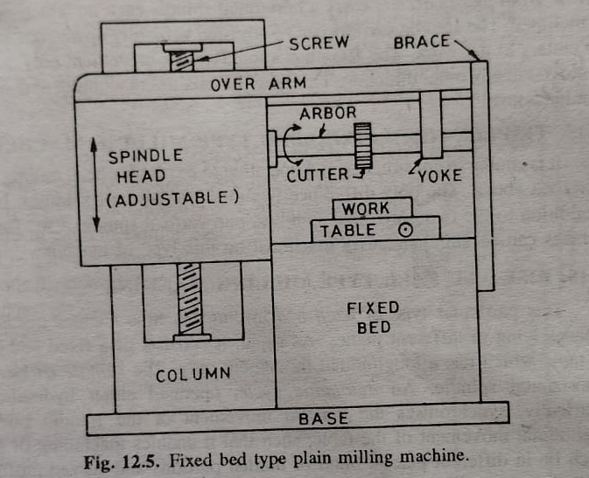

Slide 32
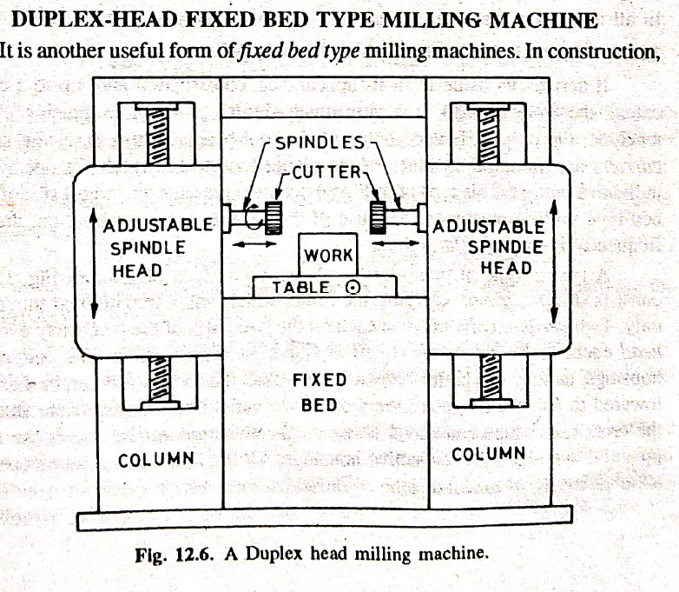

Slide 33
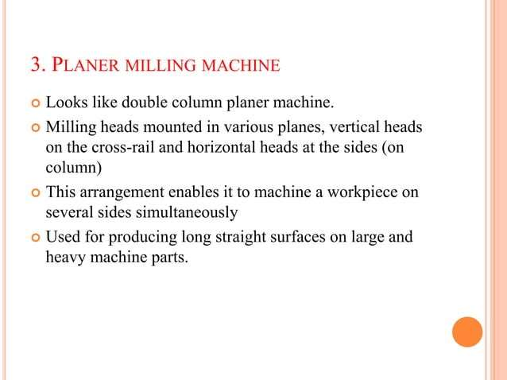

Slide 34
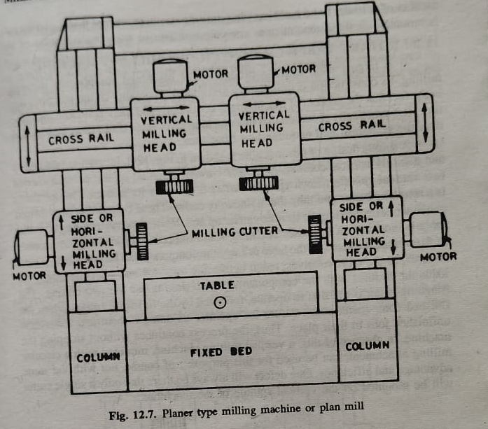

Slide 35
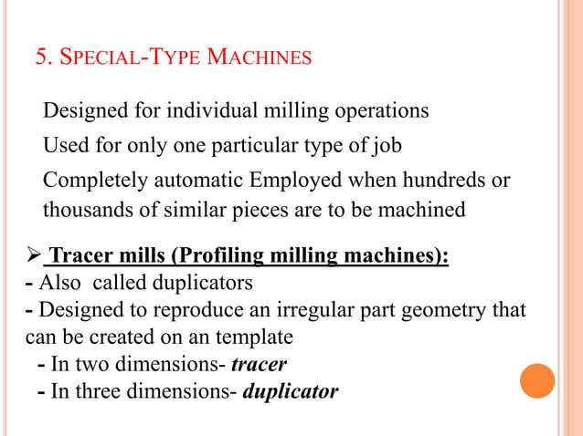

Slide 36
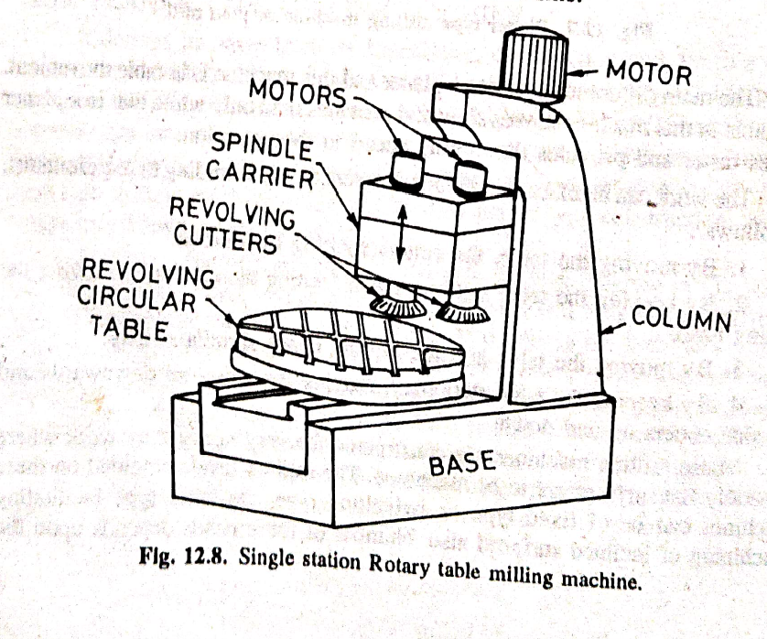
4)PRODUCTION MILLING MACHINES
Rotary table or continuous type

Slide 37
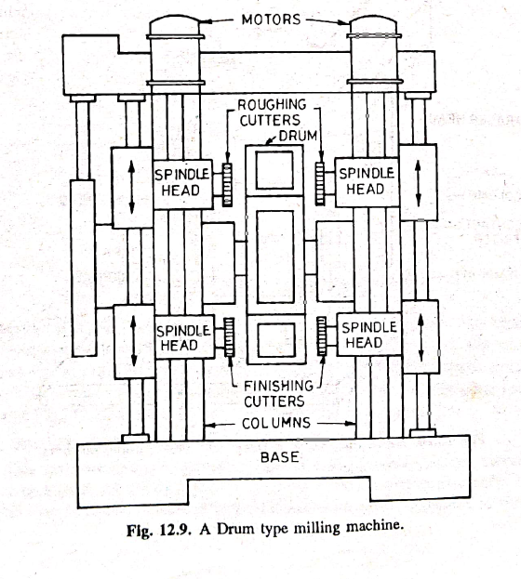
(b) Drum type milling machine

Slide 38
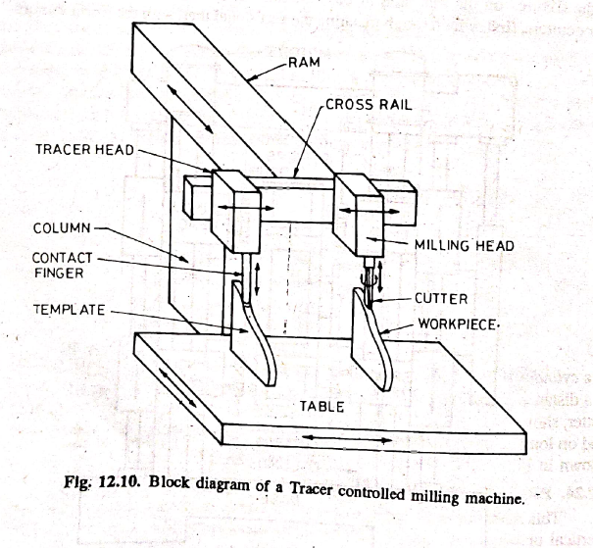
(c) Tracer Controlled milling machine

Slide 39
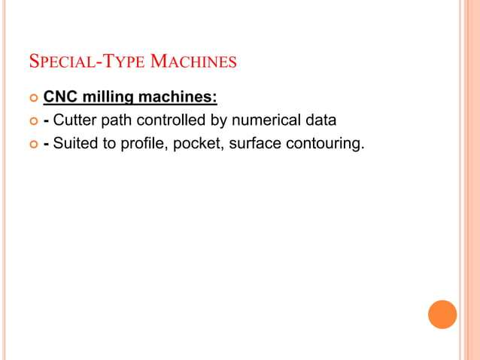

Slide 40
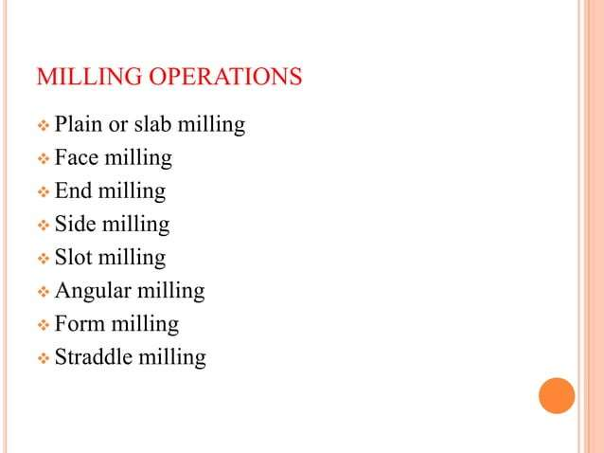

Slide 41
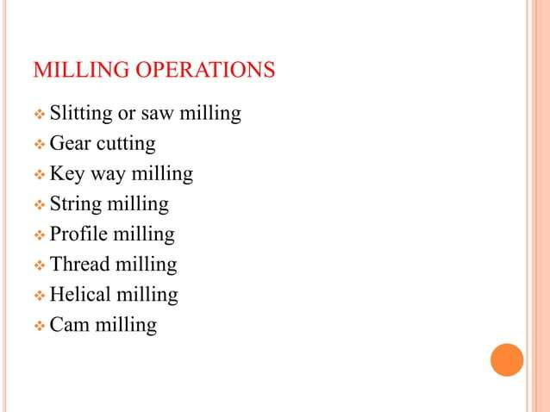

Slide 42
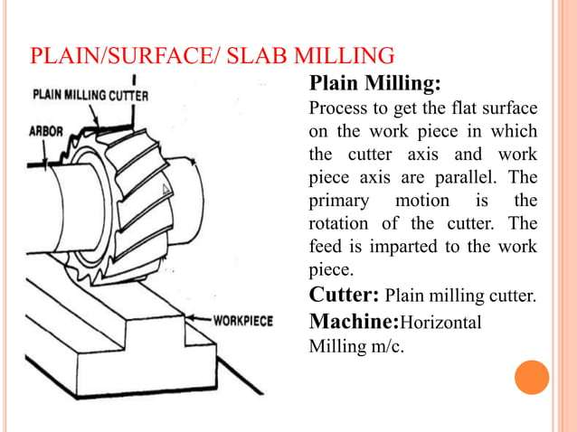

Slide 43
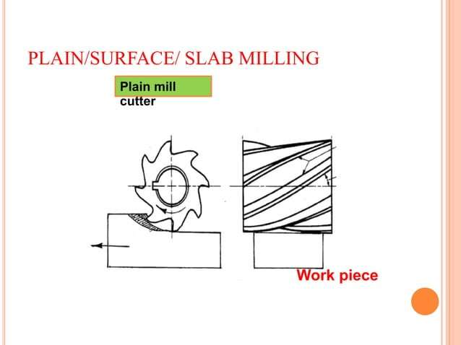

Slide 44
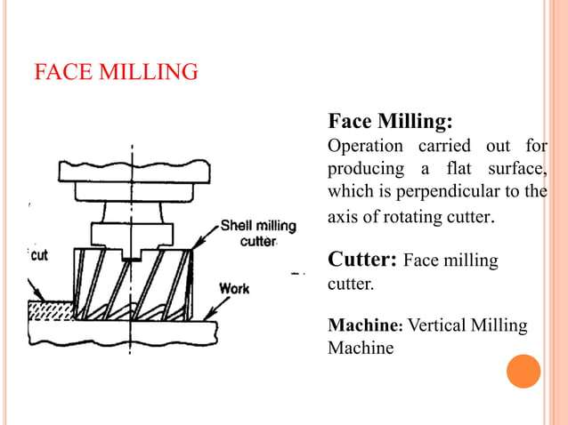

Slide 45
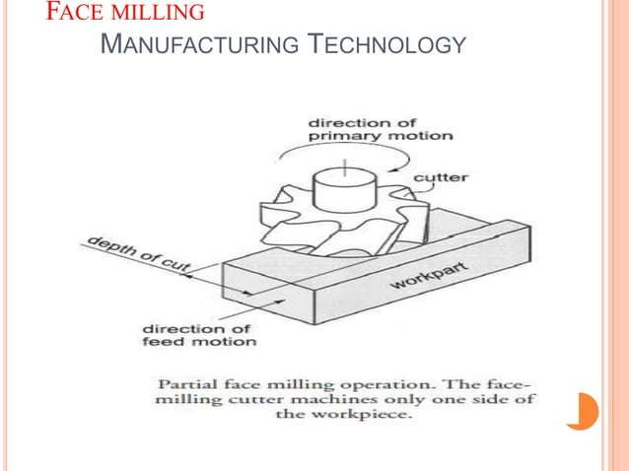

Slide 46
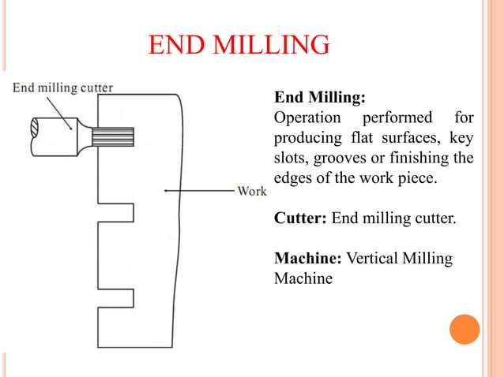

Slide 47
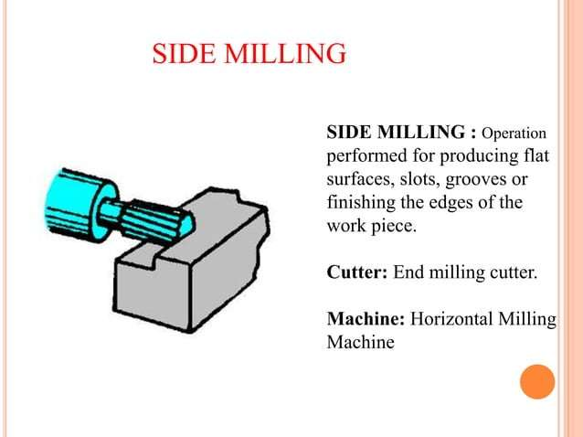

Slide 48
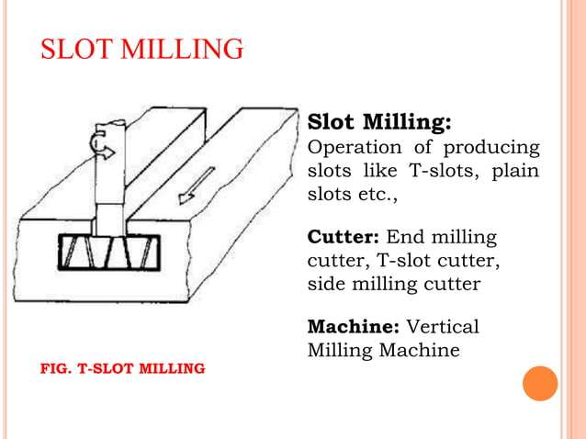

Slide 49
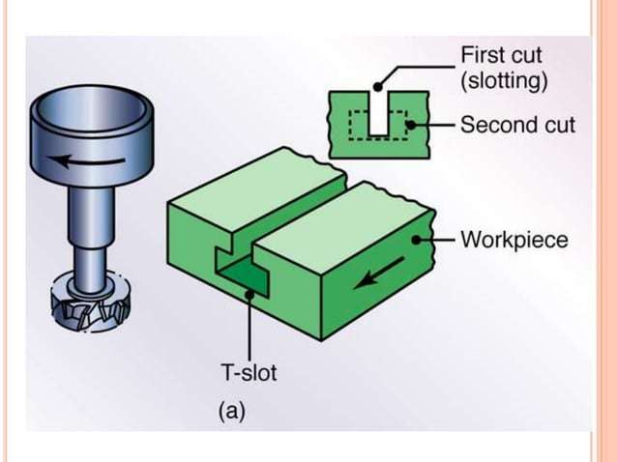

Slide 50
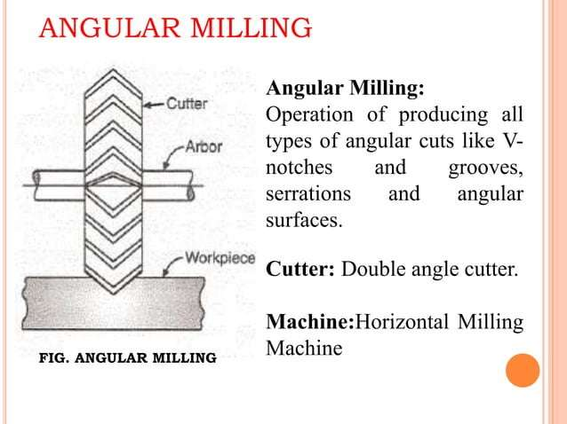

Slide 51
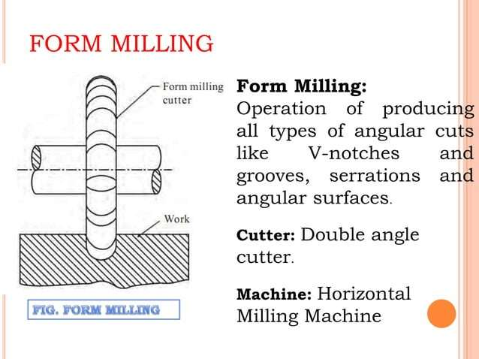

Slide 52
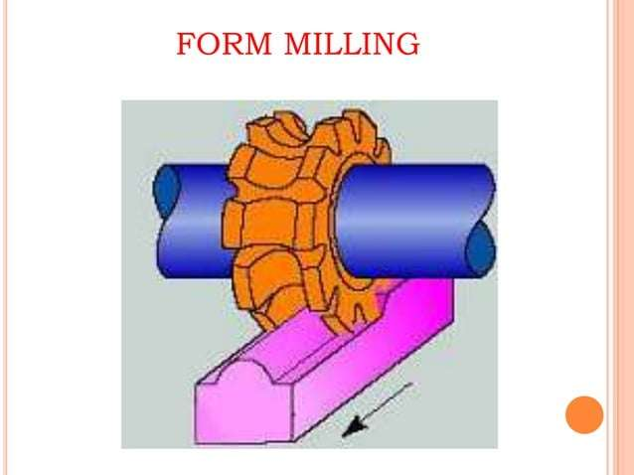

Slide 53
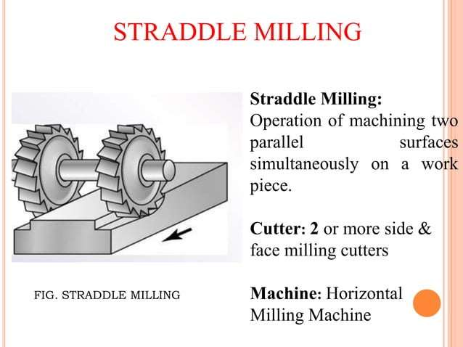

Slide 54
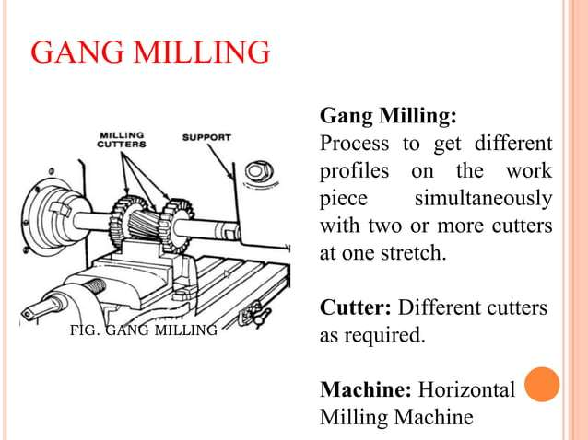

Slide 55
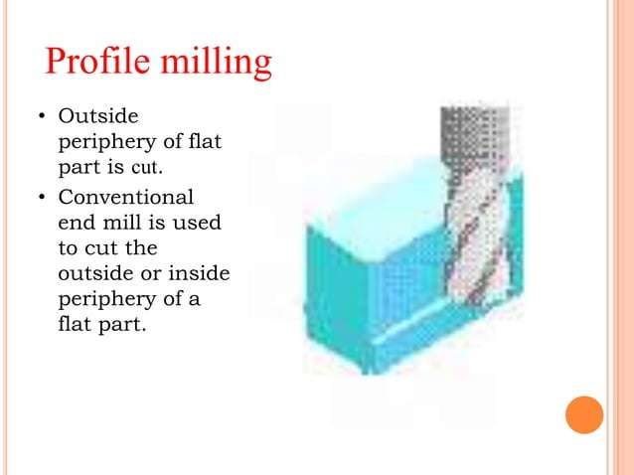

Slide 56
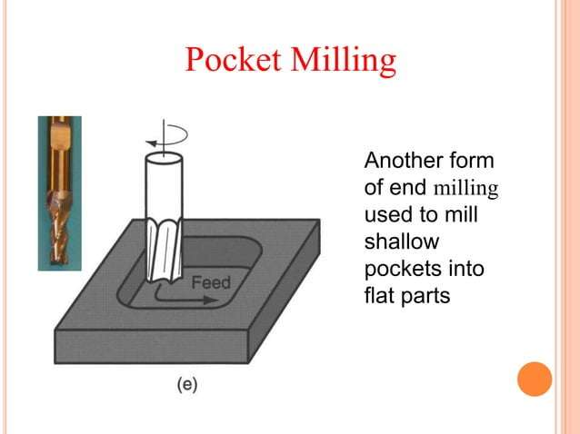

Slide 57
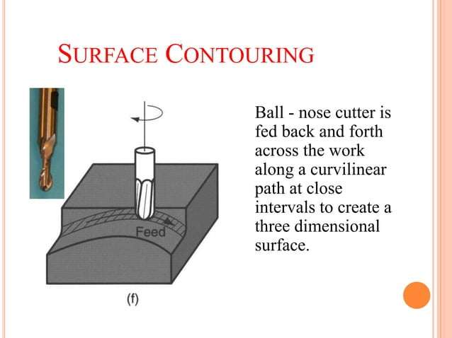

Slide 58


